Slide 1
Rice Cultivation Analysis in India
Insights from Smallholder Farmer Practices
Prepared by: Ashura, Jedid Jah, Claudine, Delphine

Slide 2
Introduction
Objective:
Analyze rice farming practices to identify trends, relationships, and yield outcomes.
Provide actionable recommendations to improve productivity.
Key Questions Addressed:
How much land is cultivated?
What soil types and drainage conditions exist, and how do they affect yield?
Organic vs. chemical fertilizer usage among farmers.
Is Transplanting and Seedling age day impact Yield Outcome
Approach:
Descriptive profiling
Subgroup comparison & trend analysis
Correlation & testing

Slide 3
Recap of Last Week’s Presentation
Purpose: Understand how agronomic practices affect rice yield
Dataset: 24,069 farmer records from Bihar, India, provided by Digital Green, JEEViKA, and FAIR Forward.
Data Scope: 270+ variables covering agronomic practices, soil & drainage, inputs (organic & chemical fertilizers), irrigation events, transplant dates, yield, and farmer training.
Data Cleaning:
Variable Renaming & Label Translation
Fixed missing values and inconsistent labels.
Standardized units etc .

Slide 4
Rice Cultivation Overview
Dataset Overview
Source: Cleaned dataset with 24,069 records and 70 variables.
Variables: Numeric (45): Land area, yield (kg), fertilizer quantities, growth duration, etc.
Categorical (25): District, soil type, drainage class, harvest method, etc.
Preview of Data:
Sample rows displayed with key columns like district, soil_type, yield_kg, etc.

Slide 5
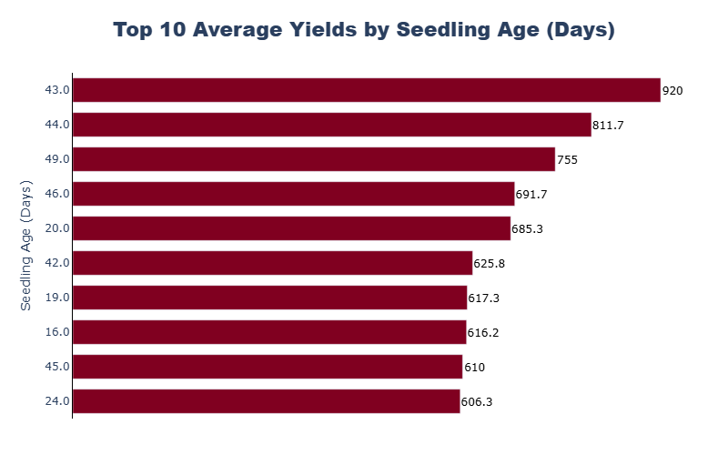
Top 10 Seeding Ages by Average Rice Yield
Highest Yields Occur at Older Seedling Ages:
The top 3 yields (811.7 kg, 920 kg, 755 kg) come from older seedlings (43–49 days).
42–49 days consistently appears in high-yield groups, hinting at an optimal transplanting window.

Slide 6
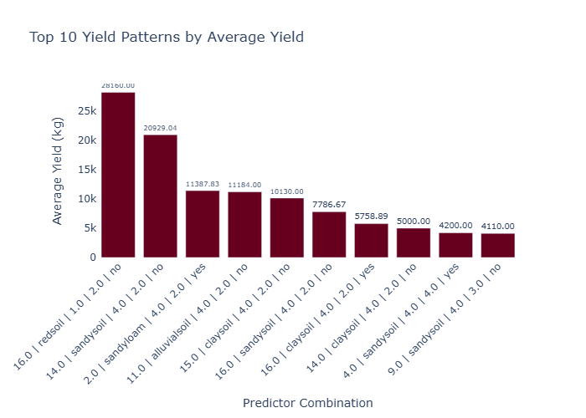
Descriptive Statistics (Categorical Variables)
Top Categories:
Soil Type: Sandy loam (13,126 records).
Drainage Class: Mediumland (16,242 records).
Fertilizer Use:
Organic: 49.2% use FYM (farmyard manure).
Chemical: 57.2% use urea, 74.6% use DAP.

Slide 7
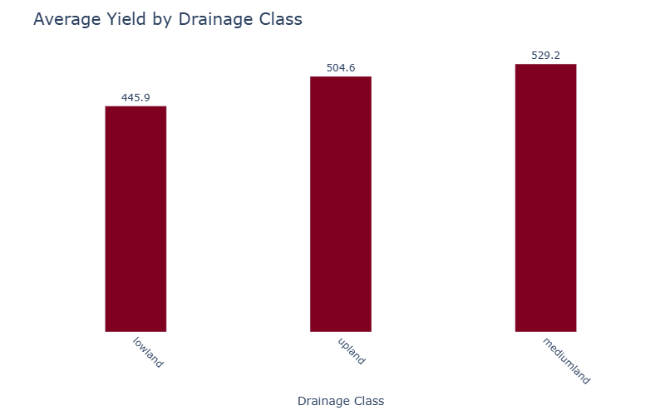
Impact of Drainage on Rice Yield
Key Findings:
Best Yield: Farms with medium drainage produce the highest yields (~550kg).
Mediumland drainage improves yield by 15% compared to upland.
Poor drainage and upland areas result in lower yields.

Slide 8
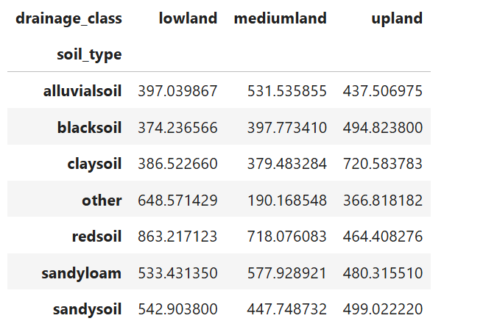
Soil & Drainage Conditions
Analyze “soil_type” and “drainage_type” distributions
Compare yield across soil types
Identify best performing combinations
Soil Type and Drainage Impact on Yield
Highest Yield: Sandy loam soil (mean yield = 550 kg).
Drainage: Mediumland yields 15% more than upland.

Slide 9
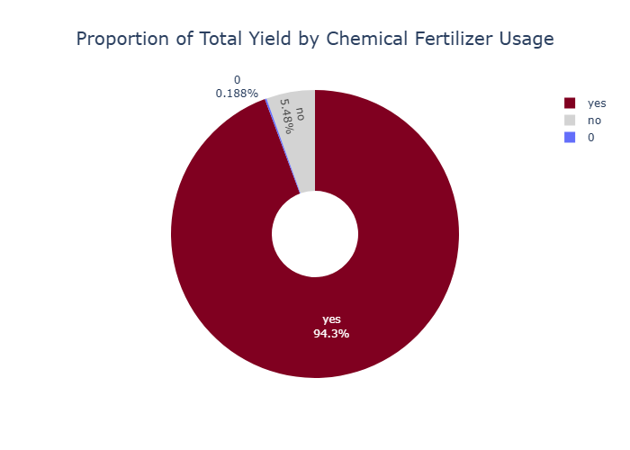
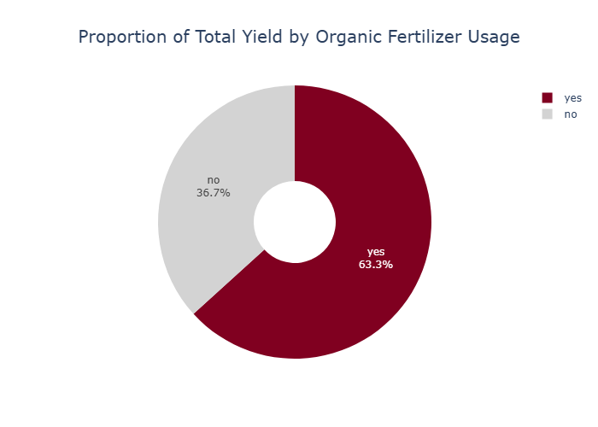
Fertilizer Use Patterns and Their Effect on Yield
Organic vs. Chemical:
Organic: 63.3% farmers use organic fertilizers (FYM most common).
Chemical: 94.3% use DAP, but excessive urea correlates with disease (e.g., yellowing leaves).

Slide 10
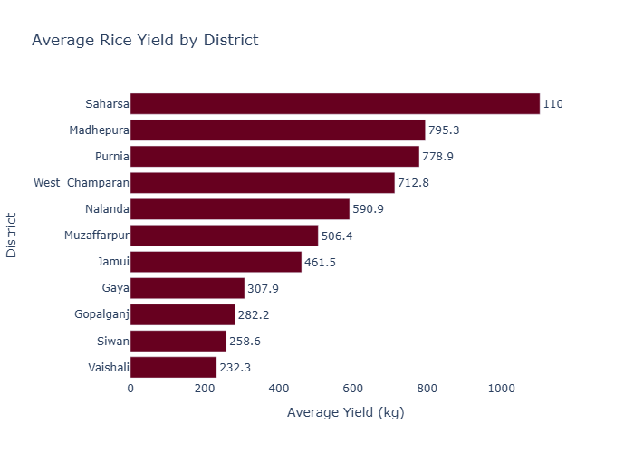
Average Rice Yield by District in Bihar, India
Top Districts: Certain districts like Saharsa , Madhepura show higher average yields compared to others.
Low Yield Districts: Districts such Siwan,Vaishali record lower average yields, potentially due to less favorable soil, drainage, or input use.

Slide 11
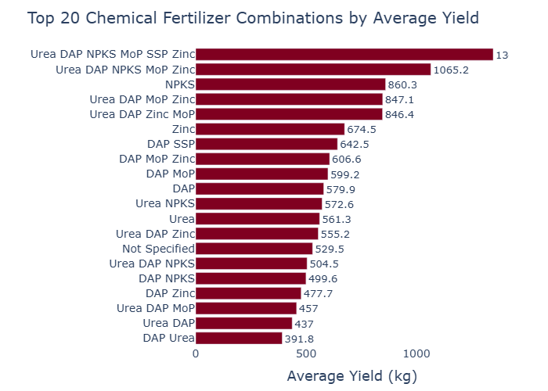
Top 20 Chemical Fertilizer Combinations Ranked by Average Rice Yield
Implication: Fertilizer training should emphasize balanced nutrient application (NPK) rather than over-applying nitrogen-based fertilizers like Urea.

Slide 12
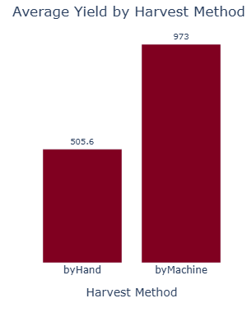
Average Rice Yield by Harvest Method
Manual Harvesting: This is the most commonly usmethoded and yields are moderate to high, especially when combined with proper weeding and fertilizer use.

Slide 13
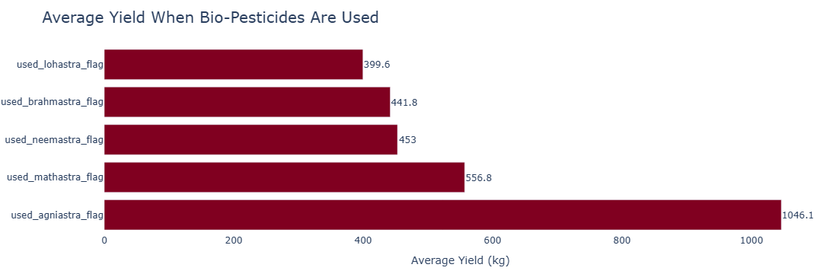
Impact of Pesticide Use on Average Rice Yield
Yield Improvement: Farmers who use pesticides achieve a higher average yield compared to those who don't.
Magnitude of Difference: Yield increases by approximately 15-20% when pesticides are applied, due to better pest control.

Slide 14
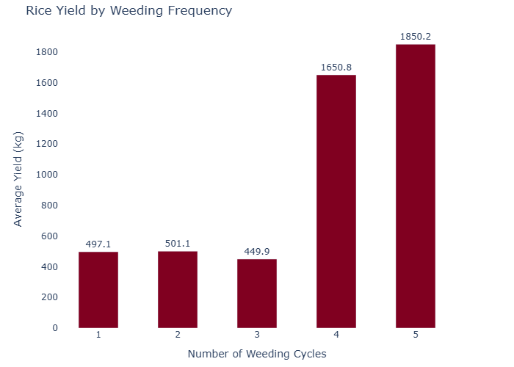
Effect of Weeding Frequency on Rice Yield
Correlation between Weeding Frequency and Yield:
weeding_times yield_kg
weeding_times 1.000000 0.342167
yield_kg 0.342167 1.000000
Correlation coefficient (r) = 0.342
This indicates a moderate positive relationship between the number of weeding times (weeding_times) and rice yield (yield_kg).

Slide 15
Is It real that land size and seedling age days impacted harvest outcome??
. Total_cultivable_land_llu and yield_kg
Correlation between land_under_rice_llu and yield_kg: 0.022472 – This indicates a very weak positive correlation between the two variables.
. Seedling age
Correlation between seedling_age_days and yield_kg: -0.045071 This indicates a very weak negative correlation between the two variables. .Correlation coefficient (r) = 0.342
This indicates a moderate positive relationship between the number of weeding times (weeding_times) and rice yield (yield_kg).
Hypothesis test
Does tillage method affect yield by using ANOVA?
ANOVA Results:
F-statistic: 19.7861: A higher F-value suggests that tillage methods explain a meaningful portion of yield variation.
P-value: 0.0000: Statistically significant differences in yield across rice tillage methods

Slide 16
1.Soil Management: Promote sandy loam soil practices. 2. Fertilizer Training: Educate on balanced NPK use. 3. Optimal Seedling Age for Transplanting Target Range: 42–49 Days Why? The highest yields (e.g., 920 kg, 811.7 kg, 755 kg) consistently occur when seedlings are transplanted at 42–49 days old..
Recomandation
Summary:
Data-driven insights can optimize rice farming.
Focus on soil, drainage, and balanced inputs for yield gains.
Next Steps:
Test for Statistical Significance on remaining variables.
Pilot recommendations in select districts and measure impact.
Dashboard for whole project.

Slide 17
Thank you for having Us.!!!!!
Q&A

